Slide 1
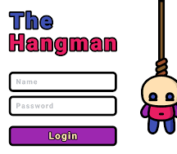
The hangman game
SANTHOSH REDDY-22831A6649

Slide 2
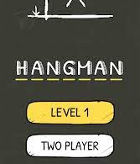
THE HANGMAN GAME
ABSTRACT
The objective of Hangman is to guess the word, letter by letter, posed by the questioner before the complete picture of the hanging man is drawn. The rules of Hangman are simple. If more than one person is guessing the letters, each one must take a turn to call out the chosen letter. This is a good exercise for teaching children to have patience.

Slide 3
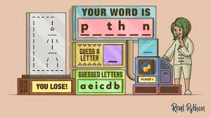
APPLICATIONS OF HANGMAN GAME
This game can have varied applications in the context of word formations and puzzles. Its knowledge can be valuable to many other games like CROSSWORD PUZZLES, WHEEL OF FORTUNE,SCRABBLE. We can also have an investigation of very popular and commonly used letters in most of the words.

Slide 4
KEY FEATURES
FEATURE 1: choosing a random word
FEATURE 2: giving finite chances
FEATURE 3: getting a hangman at every loss of chance

Slide 5
Software Requirement for Hangman
Python-3.10.0 :-
HTML :-
Using its various extensive libraries ,modules ,lists and dictionaries we create the actual core code of our game using its object oriented programming and GUI features we will create our source code
using hypertext markup language and cascading style sheets we will develop the structure and interface of our project

Slide 6
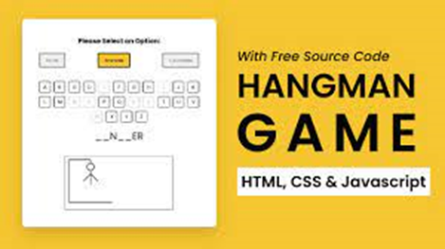
CSS:-
Cascading Style sheets are helpful for adding styles ,background ,font for a user-appealing look of our project

Slide 7
Hardware Requirement For project
RAM: 4GB
Disk Space: 1TB
Operating System: Windows
Processor : Intel i5

